Slide 1
Big Data Analytics and Mining for Effective Visualization and Trends Forecasting of Crime Data
Mingchen Feng1 , Jiangbin Zheng1 , Jinchang Ren, Amir Hussain, Xiuxiu Li , Yue Xi1 , and Qiaoyuan Liu
-Isha Kaskhedikar 1911087

Slide 2

Introduction
While big data has been employed in a diverse range of domains, its use in policing has been limited. The three main ways in which the police use big data are through the collection and storage of DNA information, mass surveillance, and predictive policing.
The technological capabilities of the police have advanced immeasurably since the starting and law enforcement agencies worldwide now have access to both a much greater volume of useable data and far more sophisticated and efficient methods of analysis.

Slide 3
BDA can help us easily identify crime patterns which occur in a particular area and how they are related with time. In this paper, state-of-the-art machine learning and big data analytics algorithms are utilized for the mining of crime data from three US cities, i.e. San-Francisco, Chicago and Philadelphia. After preprocessing, including data filtering and normalization, Google maps based geo mapping of the features are implemented for visualization of the statistical results.

Slide 4
The major contribution of this paper can be summarized as follows:
1) A series of investigative explorations are conducted to explore and explain the crime data in three US cities;
2) A novel visual representation is proposed which is capable of handling large datasets and enables users to explore, compare, and analyze evolutionary trends and patterns of crime incidents;
3) A combination and comparison of different machine learning, deep learning and time series modeling algorithms to predict trends with the optimal parameters, time periods and models.

Slide 5
The three crime datasets used for analysis are publicly available, which cover 3 cities in US, i.e. San-Francisco, Chicago, and Philadelphia.
The San-Francisco crime data: 2,142,685 crime incidents from 2003 to 2017.
Chicago crime data: 5,541,398 records, dating back from 2017 to 2003.
Philadelphia crime data: 2,371,416 crime incidents which were captured from 2006 to 2017.

Slide 6
For each entry of crime incidents in the datasets, the following 13 featured attributes are included:
IncidentNum - Case number of each incident;
Dates - Date and timestamp of the crime incident;
Category - Type of the crime. This is the target/label that we need to predict in the classification stage;
Descript - A brief note describing any pertinent details of the crime;
DayOfWeek - Day of the week that crime occurred;
PdDistrict - Police Department District ID where the crime is assigned;
Resolution - How the crime incident was resolved (with the perpetrator being, say, arrest or booked);
Address - The approximate street address of the crime incident;
X - Longitude of the location of a crime;
Y - Latitude of the location of a crime;
Coordinate - Pairs of Longitude and Latitude;
Dome - whether crime id domestic or not;
Arrest - Arrested or not;

Slide 7
DATA PREPROCESSING
For some missing coordinate attributes in Chicago and Philadelphia datasets, we imputed random values sampled from the non-missing values, computed their mean, and then replaced the missing ones.
The timestamp indicates the date and time of occurrence of each crime, we deduced these attributes into five features: Year (2003-2017), Month (1-12), Day (1-31), Hour (0-23), and Minute (0-59).
We also omit some features that unneeded like incidentNum.

Slide 8
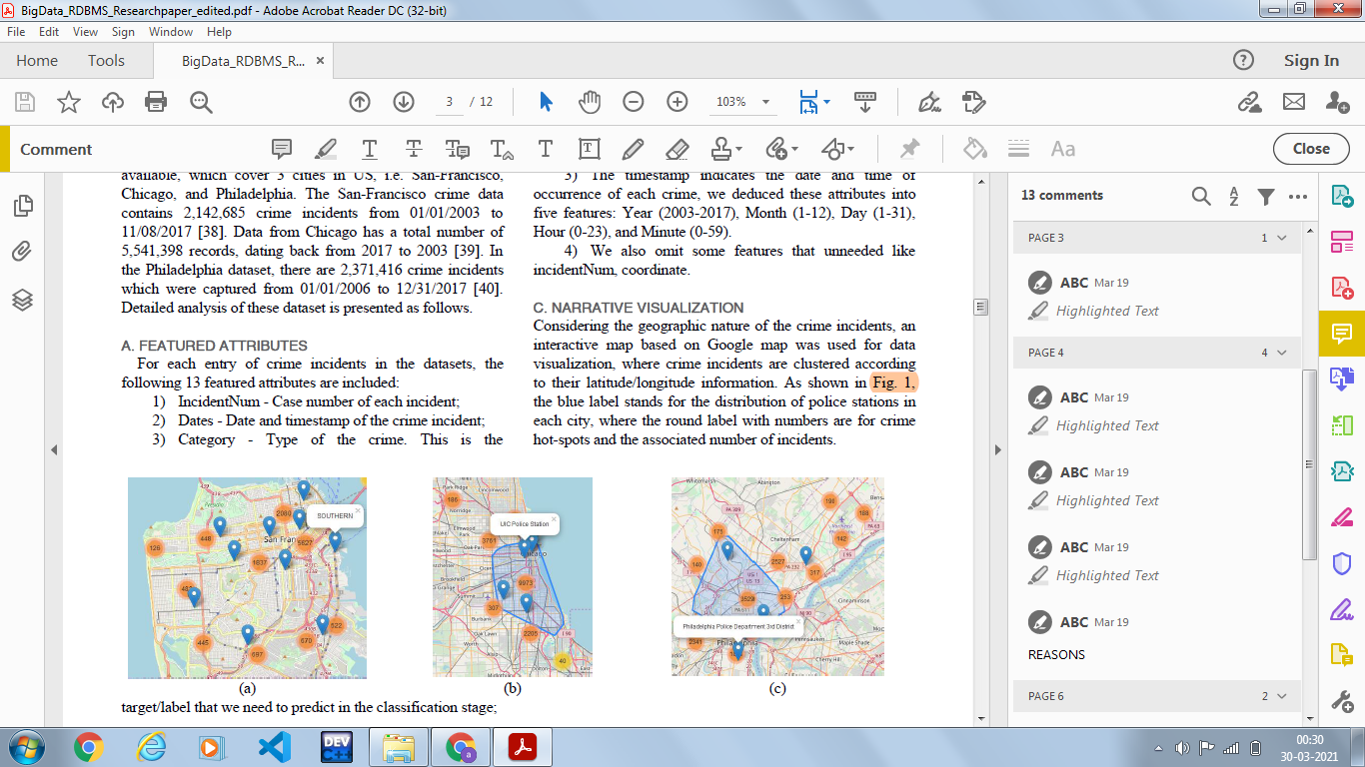
POLICE DEPARTMENTS OF ALL 3 CITIES

Slide 9
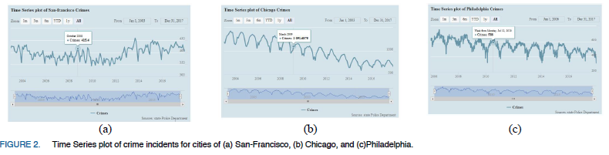
Crime incidents in each year for the
three cities

Slide 10
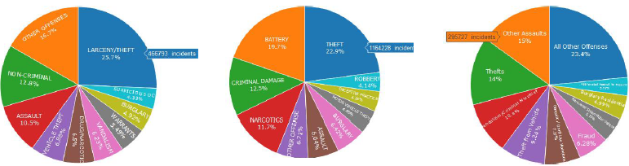
Top-10 frequently occurred crimes and their distributions as percentages

Slide 11
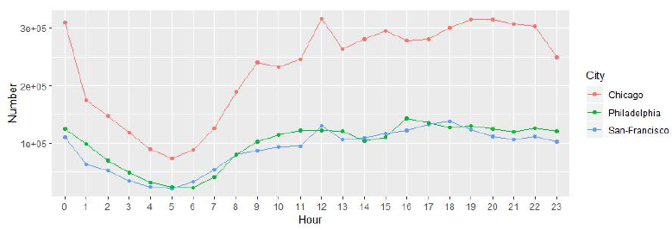
Hourly Trends

Slide 12
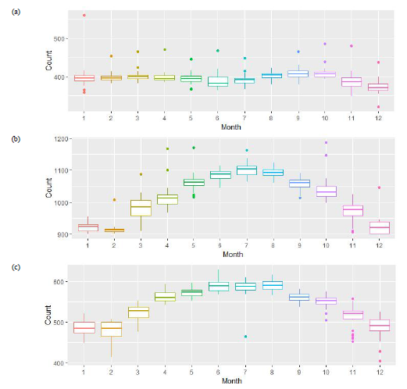
Monthly based crime statistics

Slide 13
PREDICTION MODELS

Slide 14
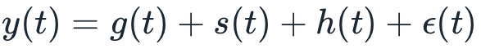
PROPHET MODEL
The Prophet model decomposes time series into three main components, i.e. the trend, seasonality, and holidays. They are combined in the following equation:
where g(t) is the trend of any non-periodic changes in the time series, s(t) represents periodic changes (e.g., weekly and yearly seasonality), and h(t) represents the holiday effects of any potentially irregular schedules over one or more days. The error term ε(t) represents any random effects which are not accommodated by the model.

Slide 15
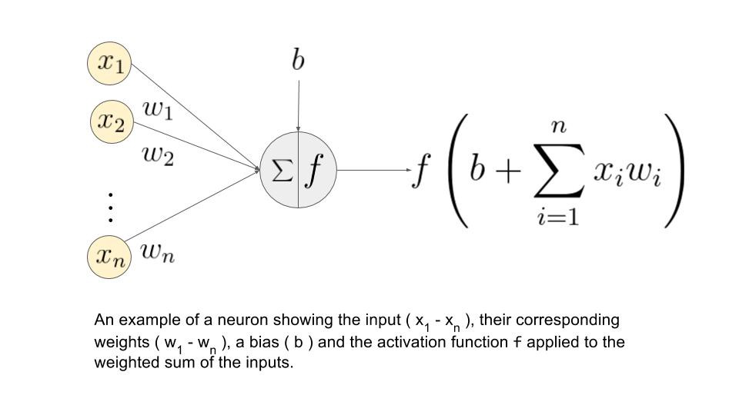
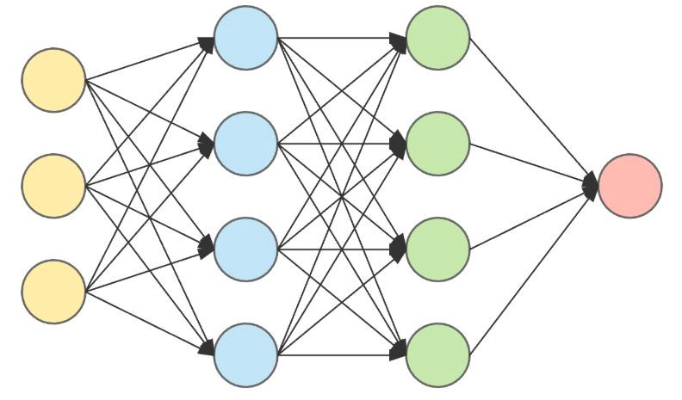
NEURAL NETWORK MODEL
A neural network is composed of a certain numbers of neurons, namely nodes in the network, which are organized in several layers and connected to each other cross different layers.
The outputs of the nodes in one layer will become the inputs to the next layer.
The inputs to each node are combined using a weighted linear combination below:

Slide 16
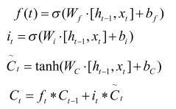
LSTM MODEL
Long Short Term Memory models are particular useful in prediction due to their capability of maintaining the state whilst recognizing patterns over the time series. The LSTM cell architecture can enhance the RNN by enabling long term persistence in addition to short term
Where, ft is a sigmoid function to indicate whether to keep the previous state, Ct-1 is the old cell state, Ct is the updated cell state, Wf, Wi, and WC are the previous value in each layer, ht-1 and xt,is the input value, bf, bi,and bc are constant values, it decides which value will be used to update the state, Ct stands for the new candidate values.

Slide 17
Experimental
Results

Slide 18
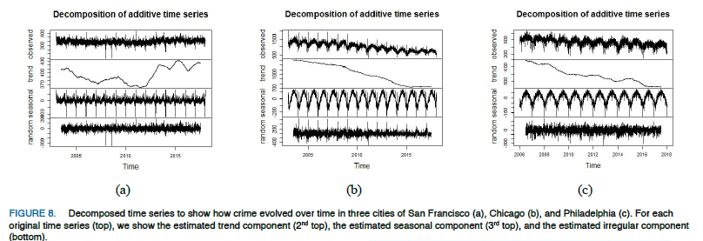

Slide 19
Result Analysis

Slide 20
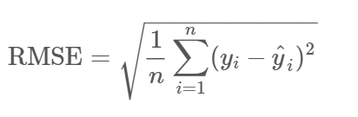
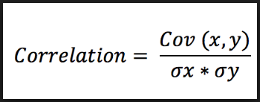
For performance evaluation, the Root Mean Square Error (RMSE) and spearman correlation [49] are used in terms of different parameters and different sizes of training samples. The RMSE and spearman correlation are defined as follows:

Slide 21
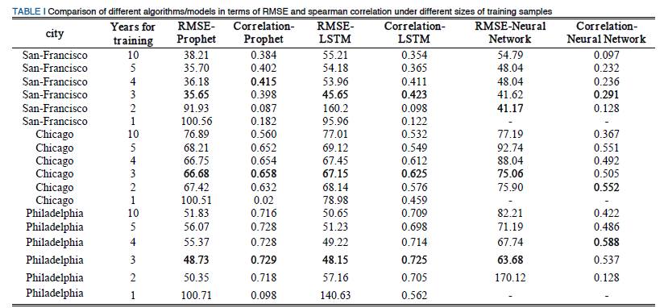

Slide 22
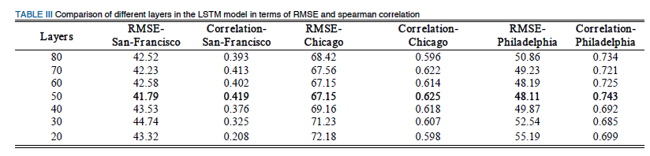

Slide 23
Prediction Analysis

Slide 24
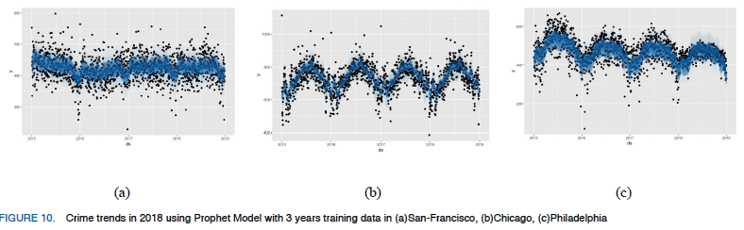

Slide 25
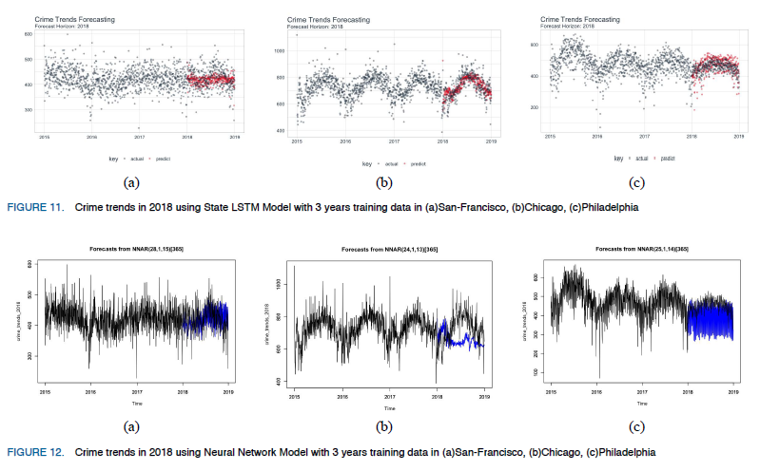

Slide 26
Conclusion
In this paper a series of big data analytics and visualization techniques were utilized to analyze crime big data from these three cities, which allowed us to identify patterns and obtain trends. The implications of machine learning and statistical techniques on crime or other big data applications such as traffic accidents or time series data, will enable the analysis, extraction and understanding of associated patterns and trends, ultimately assisting in crime prevention and management.

Slide 27
Implementation plan:
Data visualization
Applying the prediction algorithm

Slide 28
Bibliography
https://www.youtube.com/watch?v=VtItg-J6-CI&t=494s
https://colah.github.io/posts/2015-08-Understanding-LSTMs/
https://towardsdatascience.com/understanding-boxplots-5e2df7bcbd51
Google images

Slide 29
Thank You

